Slide 1

E- Travel Booking System
Using C Language..
Guide Name:
Prof. Aparna R Sawant
Batch -1 Group-1
Roll No 23 Akash Hedau,
Roll No 8 Vedang Bhange,
Roll No 7 Rahul Baviskar,
Roll No 1 Abdulrahman Ahmed,
Roll No 17 Umesh Gaikwad;
FYMCA, Vishwakarma Institute of Technology, Pune

Slide 2
Problem Statement
To create E Travel Booking System which will provide booking and cancellation process using C language. It will also generate a ticket with seat and city (from and to) selection facility . It shall also generate total amount.

Slide 3

Scope
Checking the availability status
Selecting the seat
Generating a Ticket and Amount
Providing output which will be either an input to further system or to Printer to print the ticket

Slide 4

Objectives
To create “E-Travel Booking System”
The system that manages all the information of
Seats
Fare
Buses
Passenger details. etc.
E-Ticket Generation

Slide 5
Motivation
Since, in most of the cases Booking of the buses is done manually. This increases the chance of human errors and
more time is consumed for such offline bookings.
So by using E-Travel Booking Service, the time required for
Booking will be reduced and also there will be very less
chances of errors. This makes the booking process more easy.

Slide 6
Features..
Booking and Cancellation facility as per the
the customer’s choice
Effective Filters making it more user friendly
Seat of choice

Slide 7

Requirements
Functional Requirements The system should provide facility to user to check availability of seats also enable user to book the seat of their choice. To shall enable user to select city (source city to destination) . The system shall Generate ticket based on user input. | Non Functional Requirements Efficiency- That ensures seamless booking facility Adaptability- Which will adapt to the previous work methods ensuring soft transition to Digital booking from manual Process Usability- To Provide system that is facilitating the user throughout in seat booking process. Security- Proper Authentication
Hardware Requirements Processor : Std processor with speed of 1.6 GHz RAM : 1GB or more Storage : Above 100 MB Monitor : Any Std Color monitor Printer(Optional) : Dot matrix /digital | Software Requirements Operating system : Windows 7 or above/Linux Any C Compiler user friendly to developer with recommendation enabled

Slide 8
Flowchart:
start
Login
Correct user name and password
NO
YES
view buses and available seats, Book Or Cancel a Ticket
Booked ticket can be viewed.
END

Slide 9
Structure :
Vishwakarma Travels
Login
List Of Buses
Seats Display
Taking Basic Information From Passenger Like Number of Seats, Name etc.
Confirmation/Cancellation Of Ticket
Display Of Ticket

Slide 10
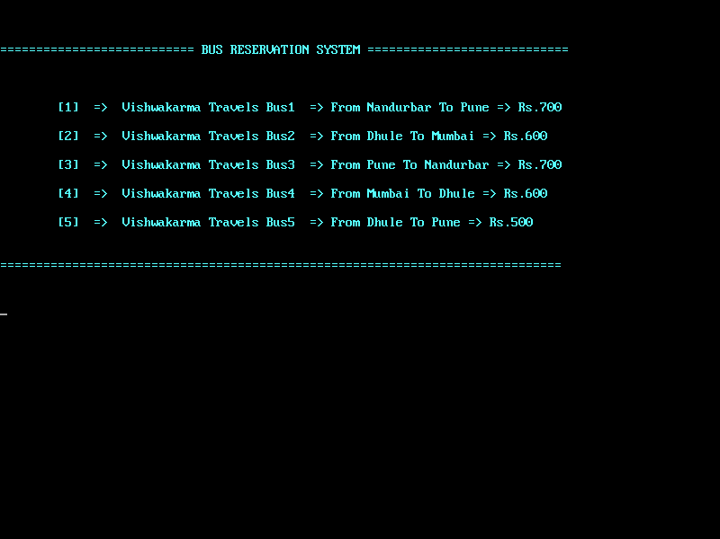
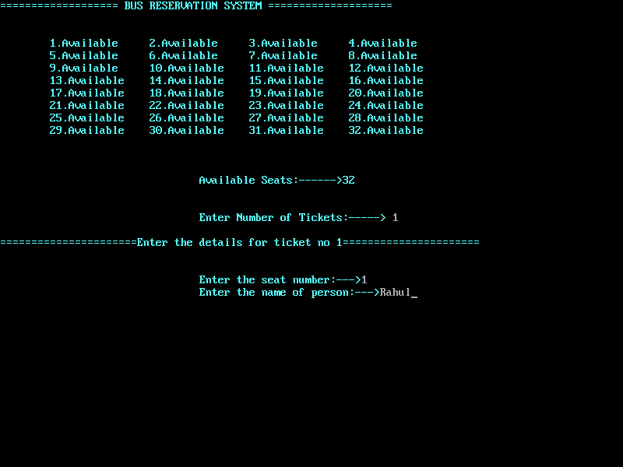
Result:

Slide 11
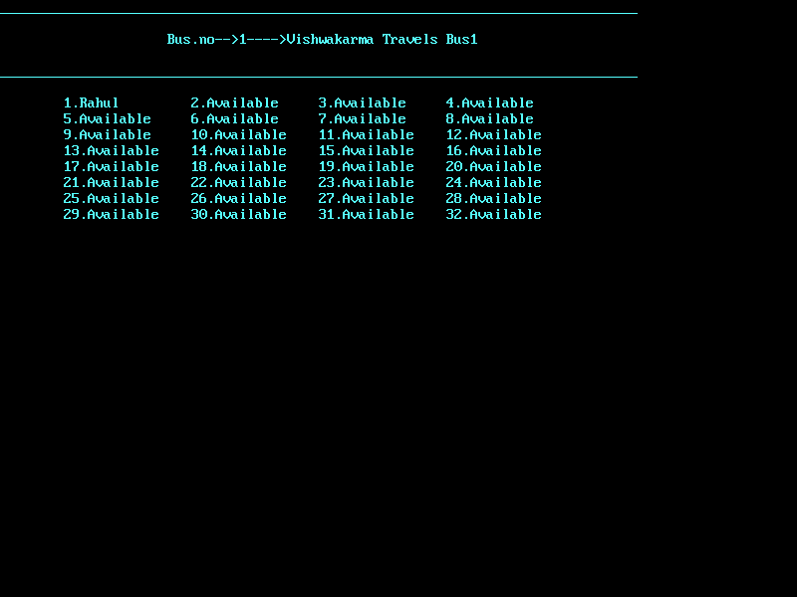
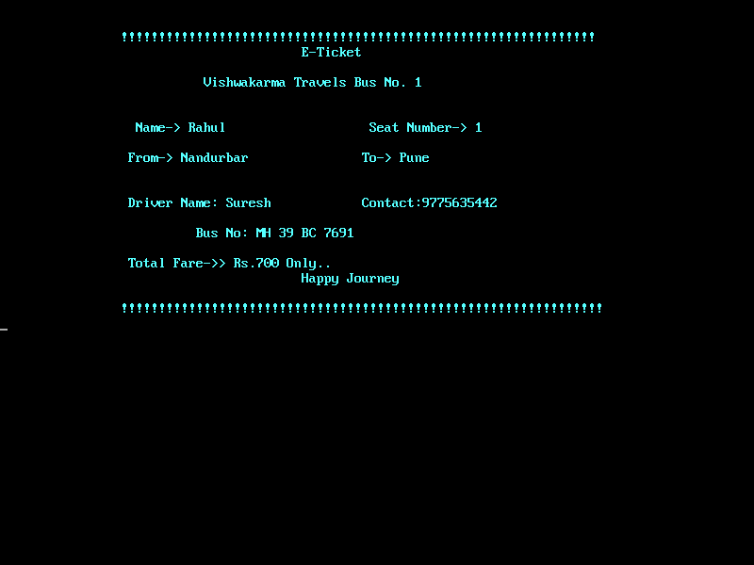
Result:

Slide 12
Conclusion:
Above project has been successfully created and it can help the Admin user to book ticket , to view the buses available with their current booking status and also can cancel the ticket facilitating the Reservation System through digital process.

Slide 13
References:
1) https://www.youtube.com/watch?v=KInH6diGthU
2) American National Standards Institute (ANSI) Escape Sequence Colour Code
3) https://code-projects.org/bus-reservation-system-in-c-programming-with-source-code/

Slide 14
Thank You..!!

